Slide 1
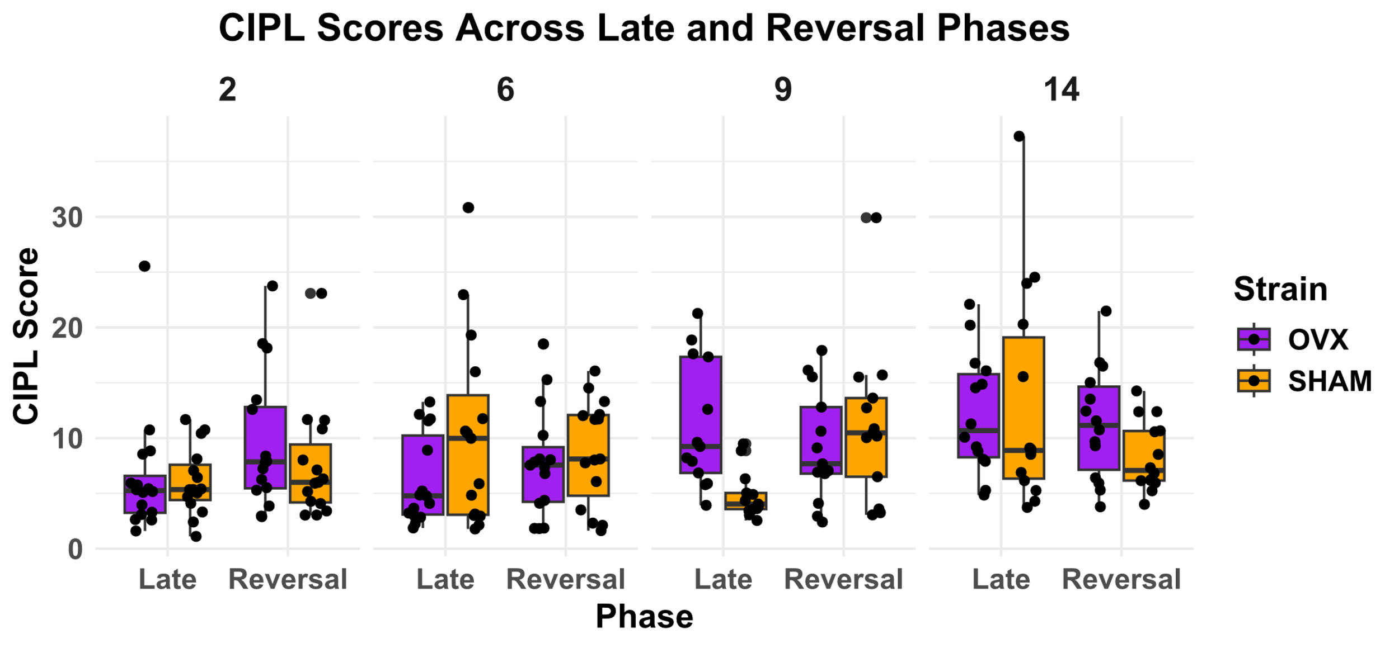
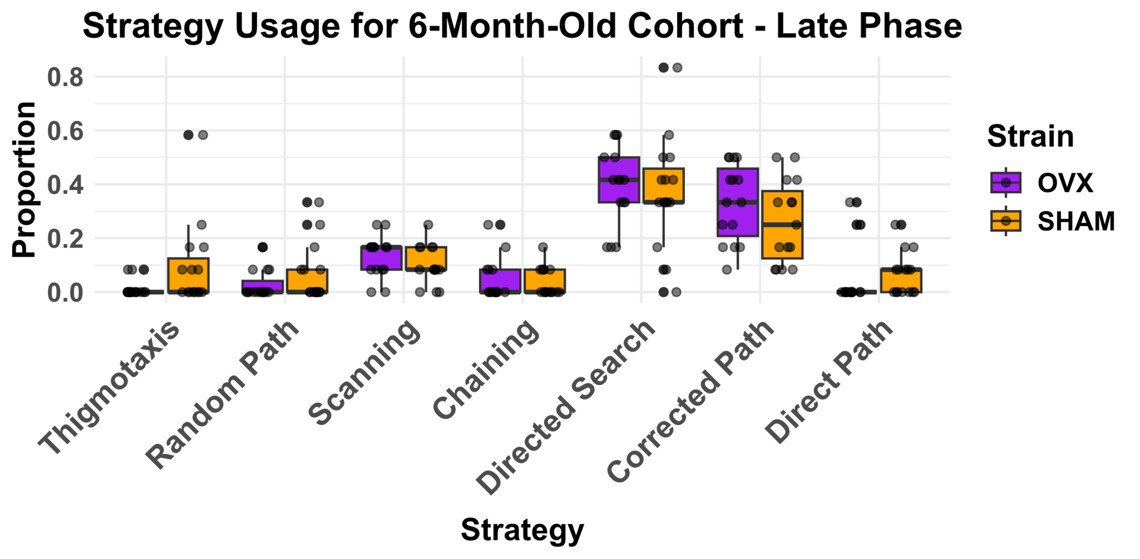
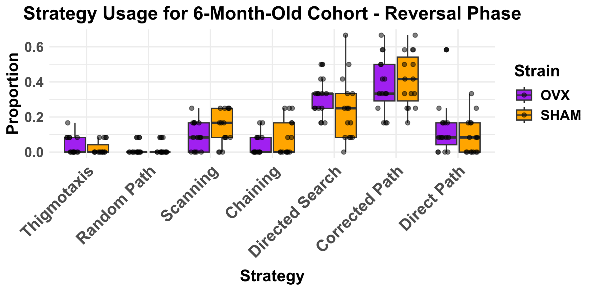
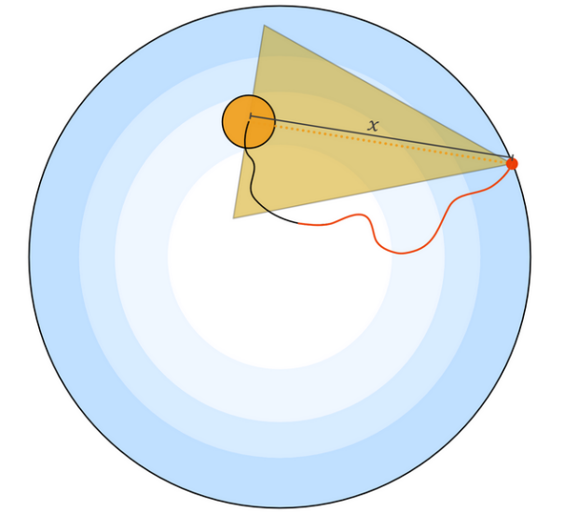
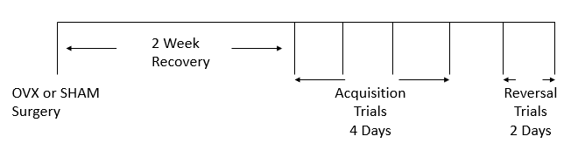
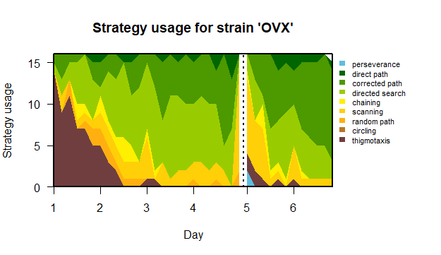
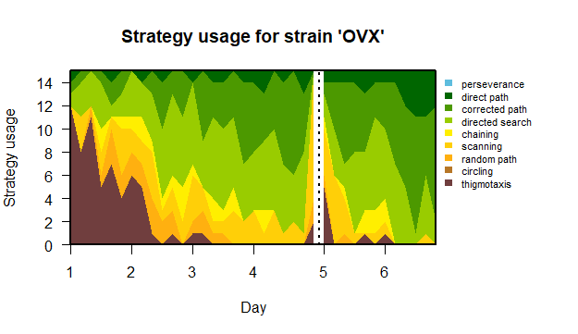
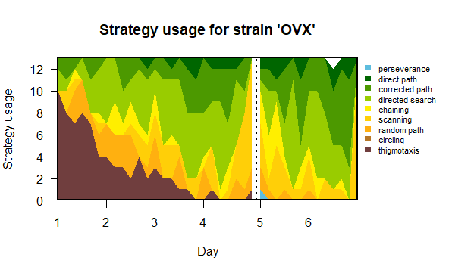
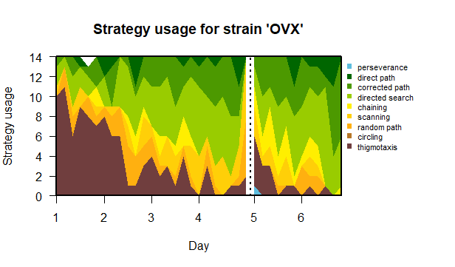
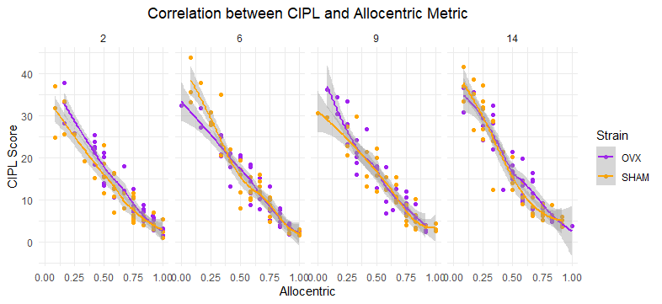
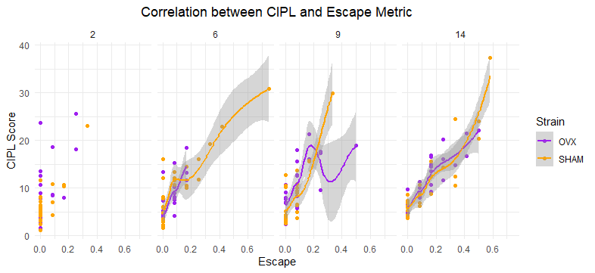
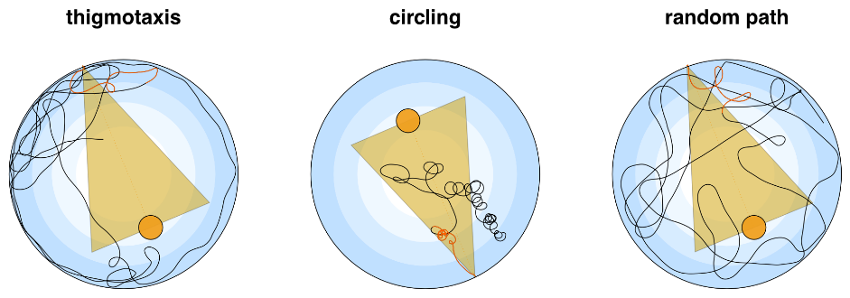
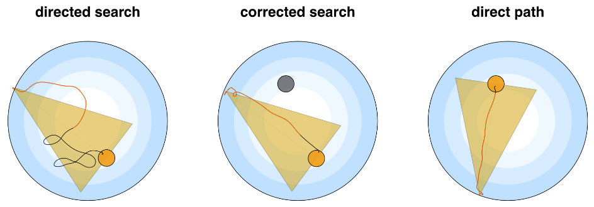
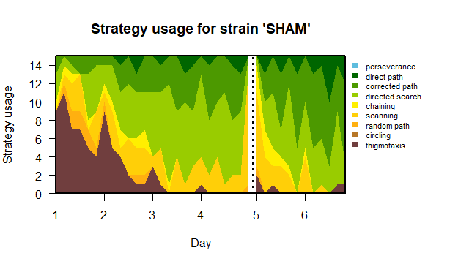
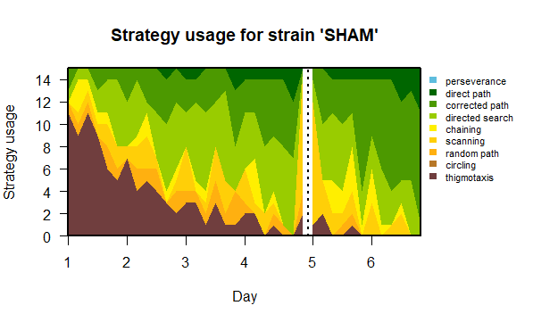
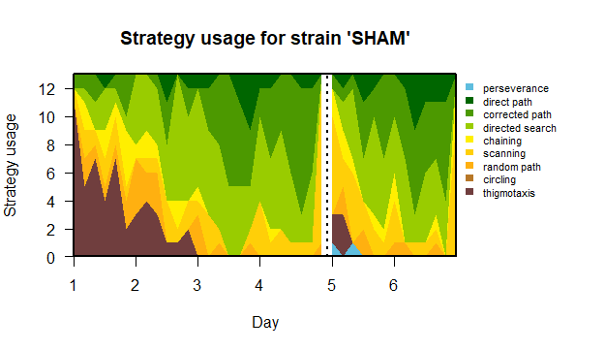
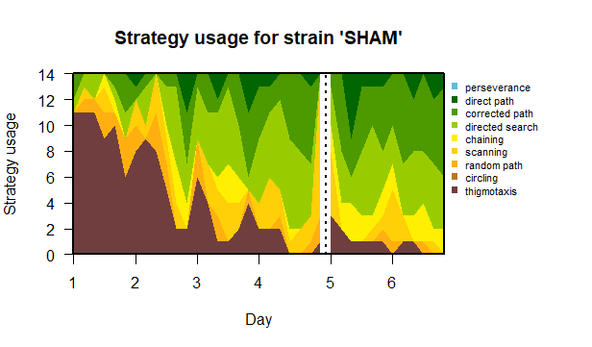
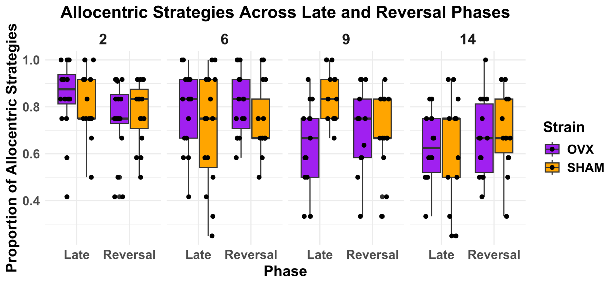
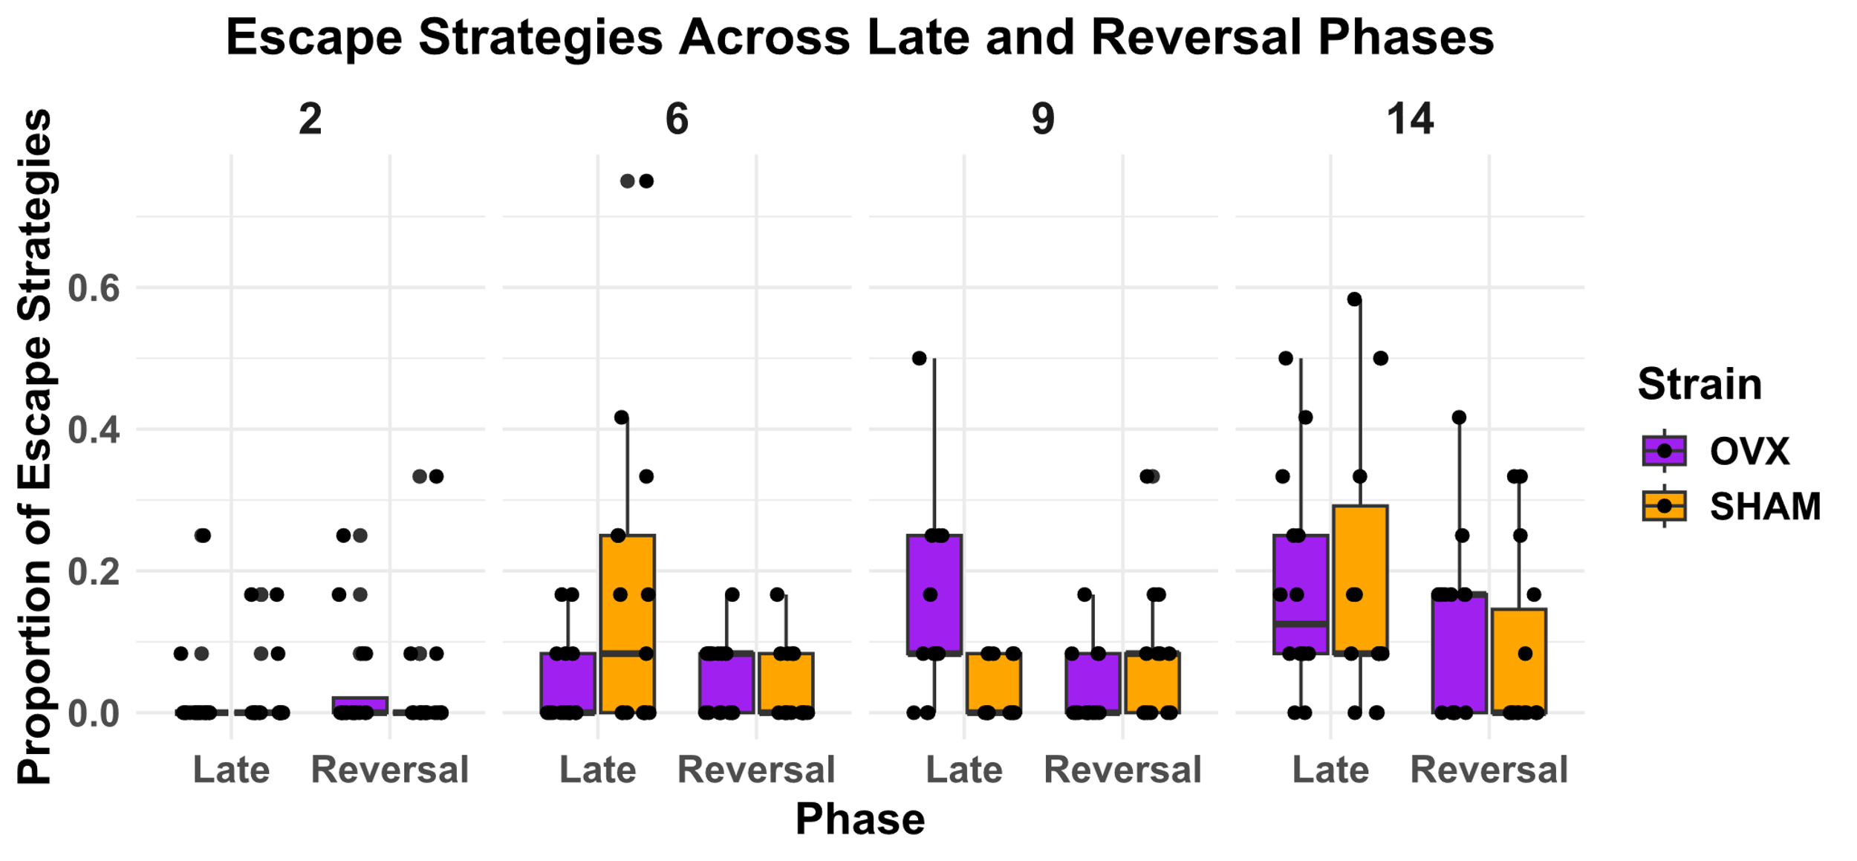
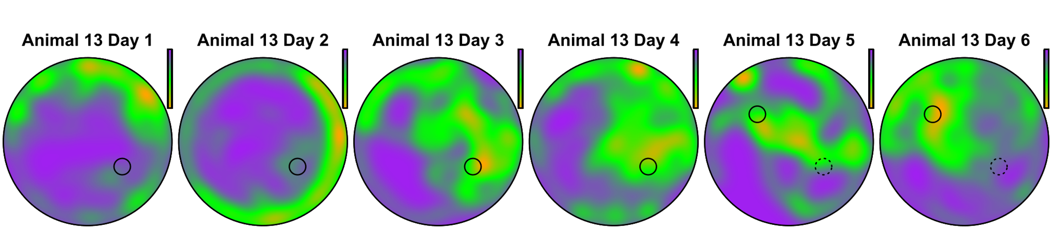
Effect of Estrogen and Progesterone Loss on Neurogenesis-related Spatial Learning and Search Strategies in Aging Female Rats
Winter, GM⁰, Corenblum, MJ¹, Pillutla, SV, Meredith, J², Wene, P³, Menakuru, N⁴, Cowen, SL⁰ and Madhavan, L^{1,5}
⁰Department of Psychology, University of Arizona, Tucson, AZ; ¹Department of Neurology. University of Arizona, Tucson, AZ; ²Molecular and Cellular Biology Undergraduate Program, University of Arizona, Tucson, AZ; ³Microbiology Undergraduate Program, University of Arizona, Tucson, AZ; ⁴Neuroscience and Cognitive Science Undergraduate Program, University of Arizona, Tucson, AZ; ⁵Bio5 Institute and Evelyn F. McKnight Brain Institute, University of Arizona, Tucson, AZ
# 74
The adult mammalian brain contains active neural stem progenitor cells (NSPCs) that generate nerve cells throughout life, and neurogenesis is compromised with advancing age. Our previous work identified a specific critical period of decline in the neurogenic ability of NSPCs, (13-15 months) in aging F344 rats. These studies focused on male rats and included the characterization of deficits in different neurogenesis-relevant behaviors.
In the current study, we utilized different groups of aging F344 female rats (2, 6, 9, and 14 months old) to examine changes in cognitive flexibility, a correlate of the neurogenic function of hippocampal NSPCs present in the subgranular zone (SGZ) of the dentate gyrus, using Reversal Learning on the Morris Water Maze task (RMWM). To probe the role of the female sex hormones, 17b-estradiol (E2) and progesterone (P4), on aging NSPC function, a group of female rats also underwent ovariectomy (OVX) 2.5 weeks prior to experiments. Standard Morris Water Maze (MWM) learning for a fixed escape location was assessed over the initial 4 days of training followed by 2 days of training on the reversal version of the task where the platform was moved 180 degrees from the original location (RMWM).
To support a fine-grained analysis of the search strategy employed by each animal, we utilized an automated system for strategy identification (Rtrack by Rupert Overall). This approach allows the identification of 9 unique search strategies during water maze performance. These strategies are classified into allocentric, or non-goal directed (escape) search strategies.
ANALYSES AND RESULTS
INDIVIDUAL STRATEGY DIFFERENCES ACROSS GROUPS
INTRODUCTION
CORRECTED PATH INTEGRATED LENGTH (CIPL) ANALYSIS
SPATIAL NAVIGATION STRATEGY ANALYSES
To assess performance, we utilized the corrected integrated path length (CIPL) measure. CIPL represents the sum of the distances from the target, corrected by subtracting the shortest possible path the rat could have taken to reach the platform at its mean speed. This measure provides a more precise understanding of the animals' navigation efficiency. We specifically focused on Days 3 and 4 for MWM (Late Phase) and Days 5 and 6 for RMWM (Reversal), as these time points reflect the animals' later stages of learning and their ability to adapt to a new platform location. By examining performance during these key phases, we aimed to capture the point at which differences in strategy usage would be most apparent, as animals should be demonstrating stable learning by the Late Phase of MWM and cognitive flexibility during the RMWM.
Given these findings, we were also interested in looking beyond the broader "Allocentric" and "Escape" strategy categories and investigating whether the OVX and SHAM groups differed in how much they relied on each specific strategy individually. Our goal was to determine if either group disproportionately relied on a particular strategy across trials.
**
Figure 8. Specific Strategy Usage Across Groups
Shown here is our 6-month-old cohort in A) Late ; and B) Reversal Phase. No significant differences were found.
A.
B.
Figure 4. Swim Path Trace
x = shortest direct path from animal starting location and the platform
In red = the actual path the animal took
Figure 1. Timeline of Experiment
Figure 5. CIPL Scores Across Late and Reversal Phases
Significant differences were found among the 9-month-old cohort for the Late Phase, which SHAM animals having lower CIPL scores, indicating better performance, relative the OVX animals.(W = 149, p = 0.008, r_{b} = -0.76)
CORRELATION BETWEEN CIPL AND STRATEGY METRICS
We next examined strategy usage directly, categorizing the strategies into two primary types: 'Allocentric' and 'Escape,' in line with existing literature on spatial navigation strategies. This approach was taken to simplify the analysis and focus on the most relevant categories that reflect goal-directed and non-goal-directed behaviors. By plotting each group's strategy usage across all trials over the 6 days (excluding probe trials), we aimed to assess how the use of these strategies evolved as the animals progressed through the task. Tracking this shift was essential to understand how quickly animals adapted their navigation strategies. As expected, both groups exhibited similar performance patterns, with a gradual shift from Escape strategies to Allocentric strategies over time, indicating that the animals were learning the platform's location in the Morris Water Maze task.
To investigate how these different performance indicators relate to one another, we conducted a Pearson correlation analysis to examine the relationship between two key measures of task performance: corrected integrated path length (CIPL) scores and each strategy metric – thereby providing insight into whether certain strategies (e.g., allocentric or escape) are associated with more efficient navigation as quantified by CIPL.
Figure 6. Strategy Usage
14-month-old
Figure 9. Correlation Between CIPL and Strategy Metrics
A) Allocentric (R = -0.88; R² = 0.78); B) Escape Correlation (R = 0.80; R² = 0.64)
2-month-old
6-month-old
9-month-old
A.
B.
Figure 2. Strategy Metrics
Thigmotaxis
Allocentric
Non-Goal Directed (Escape)
Circling
Random Path
Directed Search
Corrected Search
Direct Path
We hypothesize ovariectomized (OVX) animals, due to the absence of female sex hormones, would perform worse than animals which underwent a sham surgery (SHAM) across all age groups. Specifically, we predict that OVX animals would rely less on allocentric strategies during the Reversal Learning phase of the Morris Water Maze (RMWM), reflecting impairments in spatial learning and cognitive flexibility compared to SHAM animals.
Conversely, we also predict OVX animals will utilize a greater degree of non-allocentric or escape strategies relative to SHAM animals on the RMWM. Furthermore, we predict poorer performance on the MWM task based on the same metrics.
In terms of the overall utility of using these strategy metrics to differentiate between groups on the MWM and RMWM tasks, the results were less informative. While the strategy metrics provide insight into group performance, they did not add significant predictive power beyond what could be detected with the accepted standard performance measure, corrected integrated path length (CIPL).
However, our findings within the 9-month-old cohort offer a compelling insight into the potential effects of hormone depletion on cognitive flexibility and spatial learning in female rats. This age is particularly relevant because it coincides with the early stages of middle age in rats, a period when changes in hormone levels—especially 17b-estradiol (E2) and progesterone (P4)—begin to mirror aspects of the human menopausal transition, termed estropause. This natural decline in ovarian hormones may contribute to the cognitive impairments observed, as seen by decreased utilization of allocentric strategies in the OVX group compared to the SHAM group.
Going beyond the defined strategy metrics, we performed separate statistical tests to compare the usage of each strategy between OVX and SHAM groups. By doing so, we aimed to capture any nuanced differences in how OVX and SHAM animals approached the task. Our analysis revealed no differences across all 4 age cohorts. Taken together, we can surmise that while loss of ovarian hormones may contribute to strong changes in strategy usage (indicated by the Allocentric metric and its effects size at age 9) overall, such loss of hormones does not appear to significantly impact spatial learning and cognitive flexibility.
HYPOTHESES
DISCUSSION
Using Rtrack we were able to generate traces for each animal’s swimming path on all trials across all days of the experiment. With this we can visualize the pattern of strategies each animal gravitates toward across all trials on each successive day. Animals generally improve across days on both MWM and RMWM.
Figure 7. Strategy Metrics (Allocentric vs Escape) Across Late and Reversal Phases
Similarly to our CIPL analysis, we focused on the Late Phase for MWM and the Reversal Phase for RMWM. A Wilcoxon rank-sum test was conducted to compare Allocentric strategy usage between OVX and SHAM groups in the Late Phase. The analysis revealed a statistically significant difference, with the OVX group utilizing more A) Allocentric Strategies compared to the SHAM group (W = 29.5, p = 0.037, r_{b} = 0.65) on Days 3 and 4 for the 9-month-old cohort. This result suggests that OVX animals exhibited less reliance on goal-directed strategies as task demands increased, indicating a potential impairment in spatial learning. B) No significant differences in Escape Strategy usage was found.
SINGLE ANIMAL EXAMPLE
A.
B.
*
Figure 3. Density Plot Per Day
Data from Animal 13 – 9-month-old cohort – OVX group
MISCELLANEOUS
Funding
NSF IOS 2207023 NIH T32 AG 044402
Contact
Lalitha Madhavan – LMadhavan@arizona.edu
Gabriel Winter – GMWinter@arizona.edu

